Slide 1


Thank you
Lecture 12: The Basics of Capital Budgeting
NPV, IRR, and Other Methods
Presentation to Cox Business Students
FINA 3320: Financial Management

Slide 2
Purpose of This Lecture
Discuss the basics of capital budgeting
    (1) A Review of the Big Picture
    (2) Net Present Value (NPV)
    (3) Internal Rate of Return
    (4) NPV versus IRR
    (5) Other Capital Budgeting Techniques
Notes:
Understanding Media: Extensions of Man, published in 1964.
The medium you use to send a particular message automatically predisposes audience members to make certain tacit assumptions about the message before they even read it.
Put another way, people unconsciously judge books by their covers.
How does this apply to business communications?
If you want to announce cutbacks in your company’s health benefits, don’t deliver the message with a glitzy, over-the-top, no-expenses-spared campaign.
Conversely, if you want to position your company as a leader in innovation, don’t advertise your message on sandwich boards dangling from the necks of ragamuffins traipsing around in front of gas stations.

Slide 3
A Review of the Big Picture
Financial managers make decisions on behalf of shareholders
Managers’ goal is to make shareholders happy
  Happiness is linked to wealth (PV of future cash flows)
  Managers should maximize shareholders’ wealth
When evaluating a project…
  …If increases shareholders’ wealth, it’s good – accept
  …If decreases shareholders’ wealth, it’s bad – reject
Notes:
Understanding Media: Extensions of Man, published in 1964.
The medium you use to send a particular message automatically predisposes audience members to make certain tacit assumptions about the message before they even read it.
Put another way, people unconsciously judge books by their covers.
How does this apply to business communications?
If you want to announce cutbacks in your company’s health benefits, don’t deliver the message with a glitzy, over-the-top, no-expenses-spared campaign.
Conversely, if you want to position your company as a leader in innovation, don’t advertise your message on sandwich boards dangling from the necks of ragamuffins traipsing around in front of gas stations.

Slide 4
The Value of a Project
How do we know if taking a project will increase or decrease shareholders’ wealth?
Like any other asset, a project can be viewed as a stream of cash flows
  Write down a timeline
  Compute the present value
If a project has a present value exceeding its costs, accepting it will increase shareholders’ wealth
Notes:
Understanding Media: Extensions of Man, published in 1964.
The medium you use to send a particular message automatically predisposes audience members to make certain tacit assumptions about the message before they even read it.
Put another way, people unconsciously judge books by their covers.
How does this apply to business communications?
If you want to announce cutbacks in your company’s health benefits, don’t deliver the message with a glitzy, over-the-top, no-expenses-spared campaign.
Conversely, if you want to position your company as a leader in innovation, don’t advertise your message on sandwich boards dangling from the necks of ragamuffins traipsing around in front of gas stations.

Slide 5
Net Present Value (NPV)
NPV is the present value of future cash inflows net of the present value of all costs
  Inflows typically occur throughout the project’s life
  Outflows typically are an initial outlay (i.e., occur at time 0) and possibly some other intermediate amounts
NPV Decision Rule: Accept all projects with positive NPV
Notes:
Understanding Media: Extensions of Man, published in 1964.
The medium you use to send a particular message automatically predisposes audience members to make certain tacit assumptions about the message before they even read it.
Put another way, people unconsciously judge books by their covers.
How does this apply to business communications?
If you want to announce cutbacks in your company’s health benefits, don’t deliver the message with a glitzy, over-the-top, no-expenses-spared campaign.
Conversely, if you want to position your company as a leader in innovation, don’t advertise your message on sandwich boards dangling from the necks of ragamuffins traipsing around in front of gas stations.

Slide 6
The Discount Rate
The rate we use to discount cash flows should be related to the risk of the cash flows
  People are risk averse
  Risk-return tradeoff (i.e., higher risk = higher expected return)
  Discount rate should be expected return of a comparably risky investment
Project’s discount rate also called the opportunity cost
  Represents the expected return on the next best opportunity
The appropriate discount rate is the risk-adjusted discount rate of the project
  The firm’s WACC adjusted for the riskiness of the project compared to the risk of the average project
Notes:
Understanding Media: Extensions of Man, published in 1964.
The medium you use to send a particular message automatically predisposes audience members to make certain tacit assumptions about the message before they even read it.
Put another way, people unconsciously judge books by their covers.
How does this apply to business communications?
If you want to announce cutbacks in your company’s health benefits, don’t deliver the message with a glitzy, over-the-top, no-expenses-spared campaign.
Conversely, if you want to position your company as a leader in innovation, don’t advertise your message on sandwich boards dangling from the necks of ragamuffins traipsing around in front of gas stations.

Slide 7

NPV Example
You have the opportunity to purchase an office building. You have a tenant lined up that will generate $16,000 per year in cash flows for three years. At the end of three years you anticipate selling the building for $450,000. How much would you be willing to pay for the building if the opportunity cost is 7%?
Notes:
Understanding Media: Extensions of Man, published in 1964.
The medium you use to send a particular message automatically predisposes audience members to make certain tacit assumptions about the message before they even read it.
Put another way, people unconsciously judge books by their covers.
How does this apply to business communications?
If you want to announce cutbacks in your company’s health benefits, don’t deliver the message with a glitzy, over-the-top, no-expenses-spared campaign.
Conversely, if you want to position your company as a leader in innovation, don’t advertise your message on sandwich boards dangling from the necks of ragamuffins traipsing around in front of gas stations.

Slide 8

NPV Example
$466,000
$450,000
$16,000
$16,000
$16,000
Present Value
14,953
13,975
380,395
$409,323
0 1 2 3
Notes:
Understanding Media: Extensions of Man, published in 1964.
The medium you use to send a particular message automatically predisposes audience members to make certain tacit assumptions about the message before they even read it.
Put another way, people unconsciously judge books by their covers.
How does this apply to business communications?
If you want to announce cutbacks in your company’s health benefits, don’t deliver the message with a glitzy, over-the-top, no-expenses-spared campaign.
Conversely, if you want to position your company as a leader in innovation, don’t advertise your message on sandwich boards dangling from the necks of ragamuffins traipsing around in front of gas stations.

Slide 9

NPV Example
If the building is being offered for sale at a price of $350,000, would you buy the building? What is the added value generated by your purchase and management of the building?
Notes:
Understanding Media: Extensions of Man, published in 1964.
The medium you use to send a particular message automatically predisposes audience members to make certain tacit assumptions about the message before they even read it.
Put another way, people unconsciously judge books by their covers.
How does this apply to business communications?
If you want to announce cutbacks in your company’s health benefits, don’t deliver the message with a glitzy, over-the-top, no-expenses-spared campaign.
Conversely, if you want to position your company as a leader in innovation, don’t advertise your message on sandwich boards dangling from the necks of ragamuffins traipsing around in front of gas stations.

Slide 10
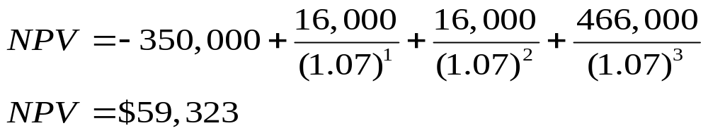
NPV Example
If the building is being offered for sale at a price of $350,000, would you buy the building? What is the added value generated by your purchase and management of the building?
Notes:
Understanding Media: Extensions of Man, published in 1964.
The medium you use to send a particular message automatically predisposes audience members to make certain tacit assumptions about the message before they even read it.
Put another way, people unconsciously judge books by their covers.
How does this apply to business communications?
If you want to announce cutbacks in your company’s health benefits, don’t deliver the message with a glitzy, over-the-top, no-expenses-spared campaign.
Conversely, if you want to position your company as a leader in innovation, don’t advertise your message on sandwich boards dangling from the necks of ragamuffins traipsing around in front of gas stations.

Slide 11
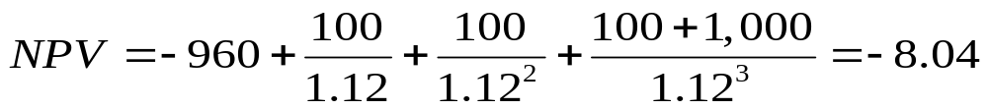
NPV in Bond Valuation
A 3-year 10% bond that makes annual payments is selling for $960. If the appropriate discount rate (i.e., YTM) is 12%, would you buy the bond?
Compute the NPV:
Notes:
Understanding Media: Extensions of Man, published in 1964.
The medium you use to send a particular message automatically predisposes audience members to make certain tacit assumptions about the message before they even read it.
Put another way, people unconsciously judge books by their covers.
How does this apply to business communications?
If you want to announce cutbacks in your company’s health benefits, don’t deliver the message with a glitzy, over-the-top, no-expenses-spared campaign.
Conversely, if you want to position your company as a leader in innovation, don’t advertise your message on sandwich boards dangling from the necks of ragamuffins traipsing around in front of gas stations.

Slide 12
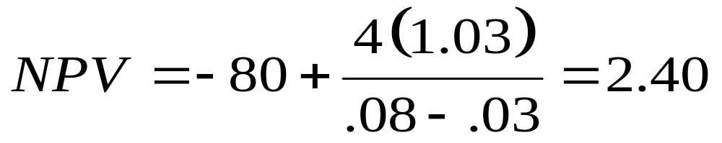
NPV in Stock Valuation
A stock just paid a dividend of $4. Its future dividends are expected to grow at 3% indefinitely and the current market price is $80. If the appropriate discount rate (i.e., required rate of return) is 8%, would you purchase the stock?
Compute the NPV:
Notes:
Understanding Media: Extensions of Man, published in 1964.
The medium you use to send a particular message automatically predisposes audience members to make certain tacit assumptions about the message before they even read it.
Put another way, people unconsciously judge books by their covers.
How does this apply to business communications?
If you want to announce cutbacks in your company’s health benefits, don’t deliver the message with a glitzy, over-the-top, no-expenses-spared campaign.
Conversely, if you want to position your company as a leader in innovation, don’t advertise your message on sandwich boards dangling from the necks of ragamuffins traipsing around in front of gas stations.

Slide 13
NPV and Other Decision Rules
NPV Decision Rule: Accept all projects with a positive NPV
  Represents optimal decision-making
  Decision determined by this rule is the optimal decision
Other decision rules…
  …May lead to sub-optimal decisions
  …Suboptimal decisions destroy value
We will discuss other decision rules and determine if they are, in fact, optimal
Notes:
Understanding Media: Extensions of Man, published in 1964.
The medium you use to send a particular message automatically predisposes audience members to make certain tacit assumptions about the message before they even read it.
Put another way, people unconsciously judge books by their covers.
How does this apply to business communications?
If you want to announce cutbacks in your company’s health benefits, don’t deliver the message with a glitzy, over-the-top, no-expenses-spared campaign.
Conversely, if you want to position your company as a leader in innovation, don’t advertise your message on sandwich boards dangling from the necks of ragamuffins traipsing around in front of gas stations.

Slide 14
The Payback Rule
Payback period is the time until cash flows recover the initial investment
The decision rule
  Only accept projects with payback periods less than some pre-specified time horizon
Does this lead to optimal decisions?
Notes:
Understanding Media: Extensions of Man, published in 1964.
The medium you use to send a particular message automatically predisposes audience members to make certain tacit assumptions about the message before they even read it.
Put another way, people unconsciously judge books by their covers.
How does this apply to business communications?
If you want to announce cutbacks in your company’s health benefits, don’t deliver the message with a glitzy, over-the-top, no-expenses-spared campaign.
Conversely, if you want to position your company as a leader in innovation, don’t advertise your message on sandwich boards dangling from the necks of ragamuffins traipsing around in front of gas stations.

Slide 15
The Payback Rule
Problem #1: Does not consider time value of money
  Payback period treats all cash flows the same no matter whether they are received at time 0 or sometime in the future
Problem #2: Ignores all cash flows occurring after the cutoff period
  Payback period considers only cash inflows until they sum to the cash outflow – all other cash flows are ignored
Notes:
Understanding Media: Extensions of Man, published in 1964.
The medium you use to send a particular message automatically predisposes audience members to make certain tacit assumptions about the message before they even read it.
Put another way, people unconsciously judge books by their covers.
How does this apply to business communications?
If you want to announce cutbacks in your company’s health benefits, don’t deliver the message with a glitzy, over-the-top, no-expenses-spared campaign.
Conversely, if you want to position your company as a leader in innovation, don’t advertise your message on sandwich boards dangling from the necks of ragamuffins traipsing around in front of gas stations.

Slide 16
The Payback Rule
Suppose the company accepts all projects with a 2-year payback period
Consider the following:
Project | CF₀ | CF₁ | CF₂ | CF₃ | Payback | NPV @ 10%
A | -2,000 | 500 | 1,000 | 10,000 | 2.05 | 6,794
B | -2,000 | 1,000 | 1,000 | 0 | 2 | -264
C | -2,000 | 0 | 2,000 | 0 | 2 | -347
Notes:
Understanding Media: Extensions of Man, published in 1964.
The medium you use to send a particular message automatically predisposes audience members to make certain tacit assumptions about the message before they even read it.
Put another way, people unconsciously judge books by their covers.
How does this apply to business communications?
If you want to announce cutbacks in your company’s health benefits, don’t deliver the message with a glitzy, over-the-top, no-expenses-spared campaign.
Conversely, if you want to position your company as a leader in innovation, don’t advertise your message on sandwich boards dangling from the necks of ragamuffins traipsing around in front of gas stations.

Slide 17
Payback Period
Unfortunately, many companies use the payback period as an initial screening device
  Companies that employ payback period as a screening tool typically state that any project that has a payback period that exceeds some pre-specified time frame are automatically rejected
Any project that meets the payback period criteria is then analyzed using some other capital budgeting technique (e.g., NPV or IRR)
As we can see from the examples on the prior page, such companies would have rejected the only positive NPV project
Notes:
Understanding Media: Extensions of Man, published in 1964.
The medium you use to send a particular message automatically predisposes audience members to make certain tacit assumptions about the message before they even read it.
Put another way, people unconsciously judge books by their covers.
How does this apply to business communications?
If you want to announce cutbacks in your company’s health benefits, don’t deliver the message with a glitzy, over-the-top, no-expenses-spared campaign.
Conversely, if you want to position your company as a leader in innovation, don’t advertise your message on sandwich boards dangling from the necks of ragamuffins traipsing around in front of gas stations.

Slide 18
Internal Rate of Return (IRR)
IRR is the discount rate that sets NPV equal to 0 (like the YTM does for a bond)
IRR Decision Rule: Accept only the projects with IRRs exceeding the discount rate (aka hurdle rate)
  Hurdle rate typically used is the project’s risk-adjusted discount rate (i.e., the company’s WACC adjusted for the risk of the project relative to the risk of an average project of the firm)
Notes:
Understanding Media: Extensions of Man, published in 1964.
The medium you use to send a particular message automatically predisposes audience members to make certain tacit assumptions about the message before they even read it.
Put another way, people unconsciously judge books by their covers.
How does this apply to business communications?
If you want to announce cutbacks in your company’s health benefits, don’t deliver the message with a glitzy, over-the-top, no-expenses-spared campaign.
Conversely, if you want to position your company as a leader in innovation, don’t advertise your message on sandwich boards dangling from the necks of ragamuffins traipsing around in front of gas stations.

Slide 19
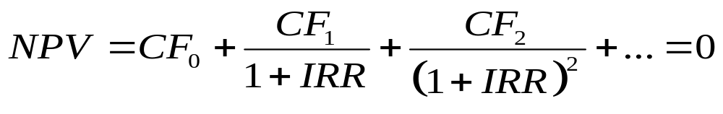
Internal Rate of Return (IRR)
IRR is the discount rate that sets NPV equal to 0 (like the YTM does for a bond)
  Without a financial calculator, determining the project’s IRR must be accomplished with trial-and-error (a tedious process)
Notes:
Understanding Media: Extensions of Man, published in 1964.
The medium you use to send a particular message automatically predisposes audience members to make certain tacit assumptions about the message before they even read it.
Put another way, people unconsciously judge books by their covers.
How does this apply to business communications?
If you want to announce cutbacks in your company’s health benefits, don’t deliver the message with a glitzy, over-the-top, no-expenses-spared campaign.
Conversely, if you want to position your company as a leader in innovation, don’t advertise your message on sandwich boards dangling from the necks of ragamuffins traipsing around in front of gas stations.

Slide 20
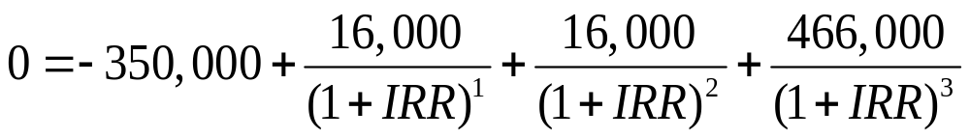
IRR Example
You can purchase a building for $350,000. The investment will generate $16,000 in cash flows (i.e., rent) during the first three years. At the end of three years you will sell the building for $450,000. What is the IRR on this investment?
IRR = 12.96%
Notes:
Understanding Media: Extensions of Man, published in 1964.
The medium you use to send a particular message automatically predisposes audience members to make certain tacit assumptions about the message before they even read it.
Put another way, people unconsciously judge books by their covers.
How does this apply to business communications?
If you want to announce cutbacks in your company’s health benefits, don’t deliver the message with a glitzy, over-the-top, no-expenses-spared campaign.
Conversely, if you want to position your company as a leader in innovation, don’t advertise your message on sandwich boards dangling from the necks of ragamuffins traipsing around in front of gas stations.

Slide 21
NPV and IRR
Recall the above example has a positive NPV when the discount rate was 7%
  So the NPV rule would have accepted the project
If 7% is the hurdle rate (i.e., the risk-adjusted discount rate for the project), the IRR also says to accept the project
Normal cash flows (1 outflow followed by a series of inflows)
  NPV and IRR lead to the same decision
  In this special case, IRR leads to optimal decision-making
Notes:
Understanding Media: Extensions of Man, published in 1964.
The medium you use to send a particular message automatically predisposes audience members to make certain tacit assumptions about the message before they even read it.
Put another way, people unconsciously judge books by their covers.
How does this apply to business communications?
If you want to announce cutbacks in your company’s health benefits, don’t deliver the message with a glitzy, over-the-top, no-expenses-spared campaign.
Conversely, if you want to position your company as a leader in innovation, don’t advertise your message on sandwich boards dangling from the necks of ragamuffins traipsing around in front of gas stations.

Slide 22
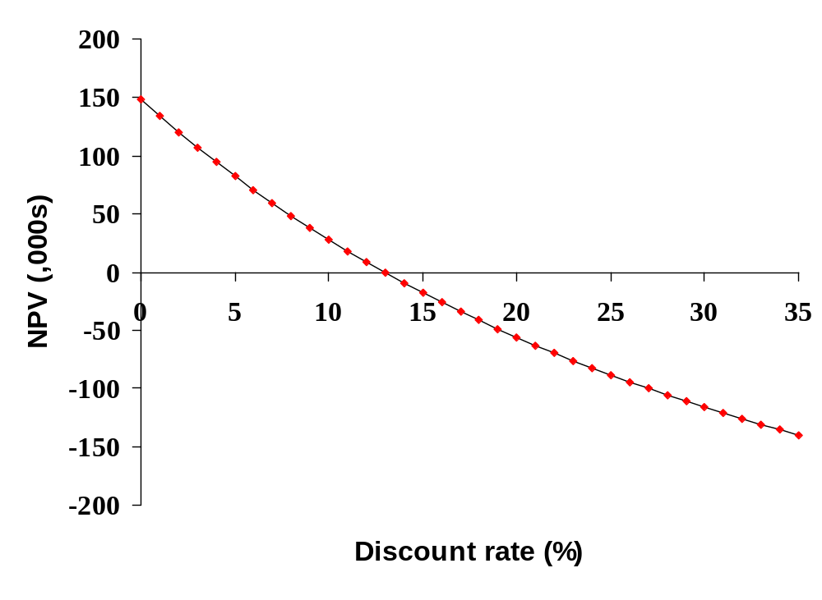
NPV and IRR
IRR=12.96%
Notes:
Understanding Media: Extensions of Man, published in 1964.
The medium you use to send a particular message automatically predisposes audience members to make certain tacit assumptions about the message before they even read it.
Put another way, people unconsciously judge books by their covers.
How does this apply to business communications?
If you want to announce cutbacks in your company’s health benefits, don’t deliver the message with a glitzy, over-the-top, no-expenses-spared campaign.
Conversely, if you want to position your company as a leader in innovation, don’t advertise your message on sandwich boards dangling from the necks of ragamuffins traipsing around in front of gas stations.

Slide 23
IRR Problems
Problem #1: Non-normal cash flows
  Possible for a project to have multiple IRRs
  Manager can’t make a decision because doesn’t know which one to use
  In general, the number of sign changes in cash flows equals the number of IRRs
Problem #2: Choosing between mutually exclusive projects
  NPV and IRR may tell the manager different things (NPV profile)
  Since we know NPV is optimal, IRR won’t always lead to the correct decision
Notes:
Understanding Media: Extensions of Man, published in 1964.
The medium you use to send a particular message automatically predisposes audience members to make certain tacit assumptions about the message before they even read it.
Put another way, people unconsciously judge books by their covers.
How does this apply to business communications?
If you want to announce cutbacks in your company’s health benefits, don’t deliver the message with a glitzy, over-the-top, no-expenses-spared campaign.
Conversely, if you want to position your company as a leader in innovation, don’t advertise your message on sandwich boards dangling from the necks of ragamuffins traipsing around in front of gas stations.

Slide 24
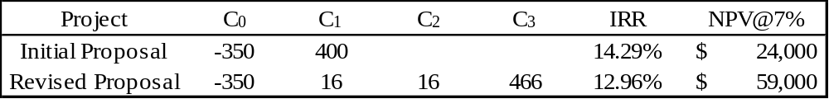
IRR Problems
You have two proposals to choose between. The initial proposal has a cash flow that is different than the revised proposal. Using IRR, which do you prefer? What about NPV?
Notes:
Understanding Media: Extensions of Man, published in 1964.
The medium you use to send a particular message automatically predisposes audience members to make certain tacit assumptions about the message before they even read it.
Put another way, people unconsciously judge books by their covers.
How does this apply to business communications?
If you want to announce cutbacks in your company’s health benefits, don’t deliver the message with a glitzy, over-the-top, no-expenses-spared campaign.
Conversely, if you want to position your company as a leader in innovation, don’t advertise your message on sandwich boards dangling from the necks of ragamuffins traipsing around in front of gas stations.

Slide 25
IRR Problems
NPV= $59,000
50
40
30
20
10
0
-10
-20
Revised proposal
NPV $ 1,000s
NPV= $24,000
IRR= 12.96%
IRR= 14.29%
Initial proposal
r= 12.26%
8 10 12 14 16
Discount rate, %
Notes:
Understanding Media: Extensions of Man, published in 1964.
The medium you use to send a particular message automatically predisposes audience members to make certain tacit assumptions about the message before they even read it.
Put another way, people unconsciously judge books by their covers.
How does this apply to business communications?
If you want to announce cutbacks in your company’s health benefits, don’t deliver the message with a glitzy, over-the-top, no-expenses-spared campaign.
Conversely, if you want to position your company as a leader in innovation, don’t advertise your message on sandwich boards dangling from the necks of ragamuffins traipsing around in front of gas stations.

Slide 26
Comparing NPV and IRR
Reinvestment rate assumption
  NPV assumes cash flows from a project can be reinvested at the project’s cost of capital (i.e., project’s risk-adjusted discount rate)
  IRR assumes that cash flow from a project can be reinvested at the project’s internal rate of return
What is the correct reinvestment rate assumption?
  Company should be able to reinvest at its WACC (or it should be paying out earning to shareholders rather than reinvesting!)
  However, a company may find it extremely difficult to reinvest at a project’s IRR if the project’s IRR is extremely high!
    If a company is unable to reinvest at the project’s IRR, then the project won’t earn its IRR (i.e., the IRR will be overstated)
Notes:
Understanding Media: Extensions of Man, published in 1964.
The medium you use to send a particular message automatically predisposes audience members to make certain tacit assumptions about the message before they even read it.
Put another way, people unconsciously judge books by their covers.
How does this apply to business communications?
If you want to announce cutbacks in your company’s health benefits, don’t deliver the message with a glitzy, over-the-top, no-expenses-spared campaign.
Conversely, if you want to position your company as a leader in innovation, don’t advertise your message on sandwich boards dangling from the necks of ragamuffins traipsing around in front of gas stations.

Slide 27
Comparing NPV and IRR
Independent projects means that the acceptance of one project doesn’t impact the decision of another project
  For projects with normal cash flows, NPV and IRR criteria always lead to the same accept/reject decision
Mutually exclusive projects mean that the manager can only invest in one project from a set of projects
  NPV will always lead to the correct accept/reject decision
  If IRR decision is different from NPV it is due to one of two potential problems:
    (1) Timing difference in cash flows
    (2) Project size or scale differences
Notes:
Understanding Media: Extensions of Man, published in 1964.
The medium you use to send a particular message automatically predisposes audience members to make certain tacit assumptions about the message before they even read it.
Put another way, people unconsciously judge books by their covers.
How does this apply to business communications?
If you want to announce cutbacks in your company’s health benefits, don’t deliver the message with a glitzy, over-the-top, no-expenses-spared campaign.
Conversely, if you want to position your company as a leader in innovation, don’t advertise your message on sandwich boards dangling from the necks of ragamuffins traipsing around in front of gas stations.

Slide 28
Comparing NPV and IRR
Capital Budgeting Decision Rule: Since NPV always provides the correct accept/reject decision, always use NPV!
Question: Why, then, do we even cover IRR?
Answer: Many managers still use IRR in their capital budgeting decision-making!
Notes:
Understanding Media: Extensions of Man, published in 1964.
The medium you use to send a particular message automatically predisposes audience members to make certain tacit assumptions about the message before they even read it.
Put another way, people unconsciously judge books by their covers.
How does this apply to business communications?
If you want to announce cutbacks in your company’s health benefits, don’t deliver the message with a glitzy, over-the-top, no-expenses-spared campaign.
Conversely, if you want to position your company as a leader in innovation, don’t advertise your message on sandwich boards dangling from the necks of ragamuffins traipsing around in front of gas stations.

Slide 29
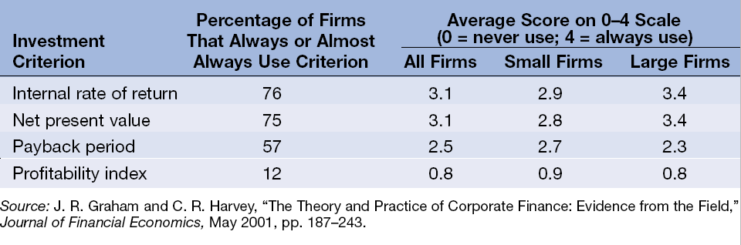
Comparing NPV and IRR
Notes:
Understanding Media: Extensions of Man, published in 1964.
The medium you use to send a particular message automatically predisposes audience members to make certain tacit assumptions about the message before they even read it.
Put another way, people unconsciously judge books by their covers.
How does this apply to business communications?
If you want to announce cutbacks in your company’s health benefits, don’t deliver the message with a glitzy, over-the-top, no-expenses-spared campaign.
Conversely, if you want to position your company as a leader in innovation, don’t advertise your message on sandwich boards dangling from the necks of ragamuffins traipsing around in front of gas stations.

Slide 30
Other Capital Budgeting Techniques
(1) Average Accounting Return (ARR)
(2) Discounted Payback Period
(3) Modified Internal Rate of Return (MIRR)
(4) Profitability Index (PI)
Notes:
Understanding Media: Extensions of Man, published in 1964.
The medium you use to send a particular message automatically predisposes audience members to make certain tacit assumptions about the message before they even read it.
Put another way, people unconsciously judge books by their covers.
How does this apply to business communications?
If you want to announce cutbacks in your company’s health benefits, don’t deliver the message with a glitzy, over-the-top, no-expenses-spared campaign.
Conversely, if you want to position your company as a leader in innovation, don’t advertise your message on sandwich boards dangling from the necks of ragamuffins traipsing around in front of gas stations.

Slide 31
Average Accounting Return (AAR)
The AAR is a measure of accounting profit relative to book value
  ARR = [Average Net Income/Average Book Value]
  The AAR is similar to the accounting return on assets (ROA)
The AAR rule is to undertake a capital budgeting project if the project’s AAR exceeds a benchmark AAR
AAR is seriously flawed for a variety of reasons
  AAR ignores time value
  AAR uses net income and book value rather than cash flows and market value (therefore not economically meaningful)
Notes:
Understanding Media: Extensions of Man, published in 1964.
The medium you use to send a particular message automatically predisposes audience members to make certain tacit assumptions about the message before they even read it.
Put another way, people unconsciously judge books by their covers.
How does this apply to business communications?
If you want to announce cutbacks in your company’s health benefits, don’t deliver the message with a glitzy, over-the-top, no-expenses-spared campaign.
Conversely, if you want to position your company as a leader in innovation, don’t advertise your message on sandwich boards dangling from the necks of ragamuffins traipsing around in front of gas stations.

Slide 32
Discounted Payback Period
The Discounted Payback Period is the length of time until the sum of an investment’s discounted cash flows equals its cost
The Discounted Payback Period rule is to undertake a capital budgeting project if the project’s discounted payback period is less than some cutoff
Discounted Payback Period is flawed
  This method ignores cash flows that occur after the cutoff period
Notes:
Understanding Media: Extensions of Man, published in 1964.
The medium you use to send a particular message automatically predisposes audience members to make certain tacit assumptions about the message before they even read it.
Put another way, people unconsciously judge books by their covers.
How does this apply to business communications?
If you want to announce cutbacks in your company’s health benefits, don’t deliver the message with a glitzy, over-the-top, no-expenses-spared campaign.
Conversely, if you want to position your company as a leader in innovation, don’t advertise your message on sandwich boards dangling from the necks of ragamuffins traipsing around in front of gas stations.

Slide 33
Modified Internal Rate of Return (MIRR)
The MIRR is a modification to the IRR where the project’s cash flows are modified by:
  (1) Discounting the negative cash flows back to the present
  (2) Compounding all cash flows to the end of the project’s life, or
  (3) Combining (1) and (2) above
An IRR is then computed on the modified cash flows
MIRRs are guaranteed to avoid the multiple rate of return problem, but:
  (1) It is unclear how to interpret them
  (2) They are not truly “internal” because they depend on externally supplied discounting or compounding rates
  (3) Most importantly, MIRR, like IRR cannot be used to rank mutually exclusive projects
Notes:
Understanding Media: Extensions of Man, published in 1964.
The medium you use to send a particular message automatically predisposes audience members to make certain tacit assumptions about the message before they even read it.
Put another way, people unconsciously judge books by their covers.
How does this apply to business communications?
If you want to announce cutbacks in your company’s health benefits, don’t deliver the message with a glitzy, over-the-top, no-expenses-spared campaign.
Conversely, if you want to position your company as a leader in innovation, don’t advertise your message on sandwich boards dangling from the necks of ragamuffins traipsing around in front of gas stations.

Slide 34
Profitability Index (PI)
The PI, also called the benefit-cost ratio, is the ratio of present value to cost
  Also called the benefit-cost ratio:
  PI = Present Value/Initial Cost
The PI rule is to undertake a capital budgeting project if the index exceeds 1
PI is similar to NPV, but like IRR it cannot be used to rank mutually exclusive projects
Notes:
Understanding Media: Extensions of Man, published in 1964.
The medium you use to send a particular message automatically predisposes audience members to make certain tacit assumptions about the message before they even read it.
Put another way, people unconsciously judge books by their covers.
How does this apply to business communications?
If you want to announce cutbacks in your company’s health benefits, don’t deliver the message with a glitzy, over-the-top, no-expenses-spared campaign.
Conversely, if you want to position your company as a leader in innovation, don’t advertise your message on sandwich boards dangling from the necks of ragamuffins traipsing around in front of gas stations.

Slide 35
Thank you
Thank You!
Charles B. (Chip) Ruscher, PhD
Department of Finance and Business Economics

